Slide 1

Unit II : Macroprocessors, Loaders And Linkers Course : Language Processor and Compiler Construction
Manisha Mali
manisha.mali@viit.ac.in
BRACT’S, Vishwakarma Institute of Information Technology, Pune-48
(An Autonomous Institute affiliated to Savitribai Phule Pune University)
(NBA and NAAC accredited, ISO 9001:2015 certified)
Department of Computer Engineering

Slide 2
Contents
Macro Processor
Macro Definition and call
Macro Expansion
Nested Macro Calls and definition
Advanced Macro Facilities
Design of two-pass Macro Processor
Loaders
Loader Schemes
Compile-and-go” loader
General loader scheme
Absolute loader (bootstrap loader)
Subroutine linkage
Relocating loader (relative loader)
Direct linking loader
Dynamic linking loader
Overlay Structure
Linkers

Slide 3
Introduction
To execute an object program, we needs
» Relocation, which modifies the object program so that it can be loaded at an address different from the location originally specified
» Linking, which combines two or more separate object programs and supplies the information needed to allow references between them
» Loading and Allocation, which allocates memory location and brings the object program into memory for execution

Slide 4
We know…
Source Program – Assembly Language
Object Program - From assembler
- Contains translated instructions and data values from the source program
Executable Code - From Linker
Loader - Loads the executable code to the specified memory locations and code gets executed.

Slide 5
LOADERS
Loader is a program which accepts the object program decks, prepare these programs for execution by the computer, and initiates the execution
Loader program loads the executable from the disk into the primary memory(RAM) for execution. It allocates the memory space to the executable module in the main memory and then transfers control to the beginning instruction of the program..

Slide 6
Role of Loader
Source
Program
Translator
Loader
Object
Program
Object program ready for execution
Translator – Assembler/Compiler
Memory

Slide 7
Linker
In computing, a linker or link editor is a computer system program that takes one or more object files (generated by a compiler or an assembler) and combines them into a single executable file, library file, or another 'object' file.
Linking is the process of combining various pieces of code and data together to form a single executable that can be loaded in memory.
Linking can be done at compile-time, at load time (by loaders) and also at run time (by application programs).
The linker program in the system is responsible for linking various object modules of the program into a single object file.

Slide 8
Role of Loader and Linker
Memory
Source
Program
Assembler
Linker
Object
Program
Object program ready for execution
Executable
Code
Loader

Slide 9
Basic Loader Functions
A Loader is a system program that performs the loading function
It brings object program into memory and starts its execution

Slide 10
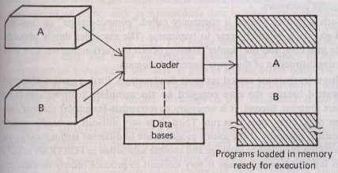
General loading scheme

Slide 11
Type of Loaders
“Compile-and-go” loader
General loader scheme
Absolute loader (bootstrap loader)
Subroutine linkage
Relocating loader (relative loader)
Direct linking loader
Dynamic linking loader
Overlay structure

Slide 12
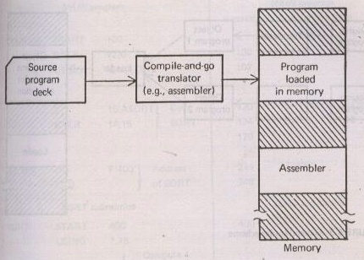
1. Assemble-and-go Loader OR Compile-and-go loader
Translate –and-go loader

Slide 13
Functions of loaders
Allocation : Allocate space in memory for the program
Linking : Resolve symbolic references between object decks
Relocation : Adjust all address dependent locations, such as address constants, to correspond to the allocated space
Loading : Physically place the machine instructions and data into memory.

Slide 14
Assemble-and-go Loader
Characteristic
the object code is stored in memory after assembly
single JUMP instruction
Advantage
simple, developing environment
Disadvantage
whenever the assembly program is to be executed, it has to be assembled again
programs have to be coded in the same language

Slide 15
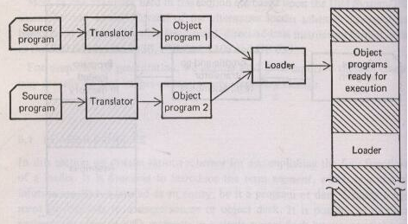
2. General loader scheme

Slide 16
3. Absolute Loader
Operation is very simple
The object code is loaded to specified locations in the memory
At the end the loader jumps to the specified address to begin execution of the loaded program

Slide 17
Role of Absolute Loader
Absolute
Loader
1000
Object
Program
Object program ready for execution
2000
Memory

Slide 18
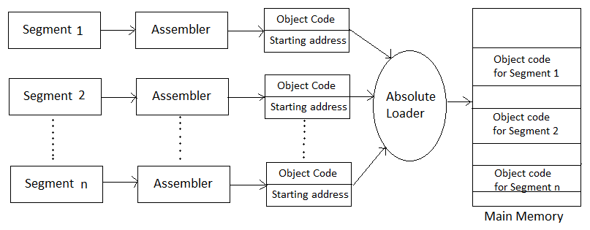
Absolute Loader

Slide 19
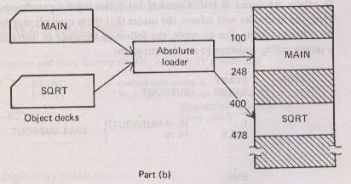
Absolute Loader

Slide 20
Absolute Loader
Four functions are accomplished as
Allocation – by programmer
Linking – by programmer
Relocation – by assembler
Loading – by loader

Slide 21
Absolute Loader
Advantages:
It is simple to implement.
This scheme allows multiple programs or the source programs written in different languages. If there are multiple programs written in different languages then the respective language assembler will convert it to the language and common object file can be prepared with all the ad resolution.
The task of loader becomes simpler as it simply obeys the instruction regarding where to place the object code to the main memory.
The process of execution is efficient.

Slide 22
Absolute Loader
Disadvantages:
In this scheme, it's the programmer's duty to adjust all the inter-segment addresses and manually do the linking activity. For that, it is necessary for a programmer to know the memory management.
If at all any modification is done to some segment the starting address of immediate next segments may get changed the programmer has to take care of this issue and he/she needs to update the corresponding starting address on any modification in the source

Slide 23
4. Subroutine linkage
Subroutine linkage method is a way in which computer call and return the Subroutine. The simplest way of Subroutine linkage is saving the return address in a specific location, such as register which can be called as link register call Subroutine.

Slide 24
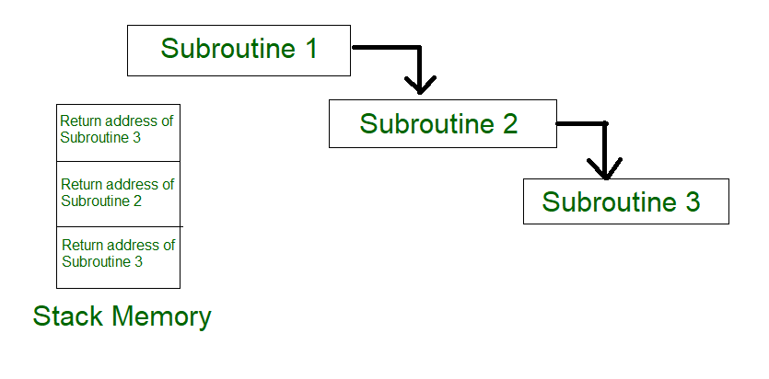
4. Subroutine linkage

Slide 25
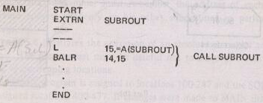

4. Subroutine linkage

Slide 26
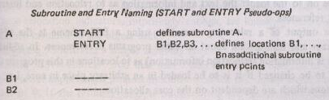
Subroutine linkage
Assembler linkage pseudo-ops
Uses of multiple entry points are
Common coding
Collecting together related routines for convenience
Better or convenient access to common data base

Slide 27
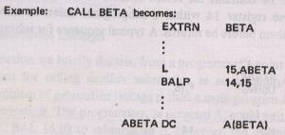
Subroutine linkage
Subroutine reference (EXTRN pseudo-op)

Slide 28
5. Relocating Loaders
A relocating loader is capable of loading a program to begin anywhere in memory:
Efficient sharing of the machine with larger memory and when several independent programs are to be run together
Support the use of subroutine libraries efficiently
The addresses produced by the compiler run from 0 to L–1. After the program has been loaded, the addresses must run from N to N +L–1.
Therefore, the relocating loader adjusts, or relocates, each address in the program.

Slide 29
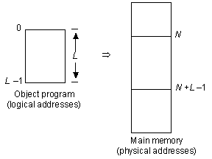
Relocating Loaders

Slide 30
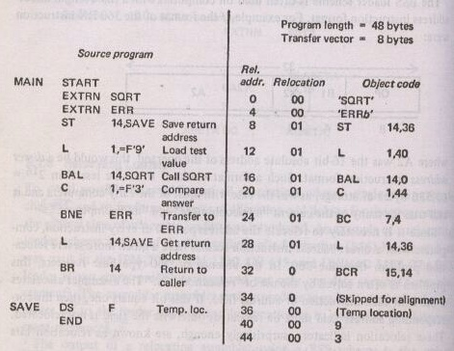
Relocating loader (relative loader) Assembly of program for “direct-address”360 that uses a BSS loader BSS : Binary Symbolic Subroutine used in IBM 7094, IBM 1130, GE 635 and UNIVAC 1108

Slide 31
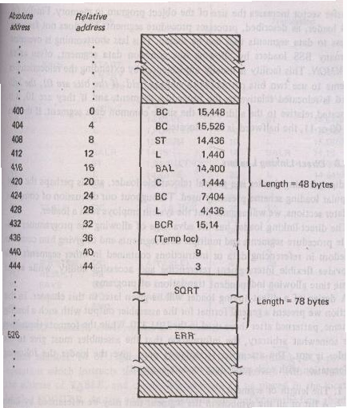
Relocating loader (relative loader) BSS loading of program for “direct access”360 BSS (Binary Symbolic Subroutine)

Slide 32
Relocating loader (relative loader)
Relocation bits : used to solve the problem of relocation
The transfer vector : used to solve the problem of linking
The program length information : used to solve the problem of allocation

Slide 33
Relocating loader (relative loader) Disadvantages
The transfer vector linkage is only useful for transfers, is not well-suited for loading or storing external data (data located in another procedure segment)
The transfer vector increases the size of the object program in memory
The BSS (Binary Symbolic Subroutine) loader processes procedure segments but does not facilitate access to data segments that can be shared

Slide 34
6. Direct linking loader
A general relocatable loader
The most popular loading scheme presently used
It allows the programmer multiple procedure segments and multiple data segments and gives complete freedom in referencing data or instructions contained in other program
It provides flexible intersegment referencing and accessing ability, while at the same time allowing independent translations of programs

Slide 35
Direct linking loader
Assembler must give the loader
The length of the segment
A list of all the symbols in the segment that may be referenced by other segments and their relative locations within the segment
A list of all symbols not defined in the segment but referenced in the segment
Information as to where address constants are located in the segment and a description of how to revise their values
The machine code translation of the source program and the relative addresses assigned

Slide 36
Direct-linking loader
Four sections of the object deck
External Symbol Dictionary cards (ESD)
Instructions and data cards, called “text” of program (TXT)
Relocation And Linkage Directory cards (RLD)
End card (END)

Slide 37
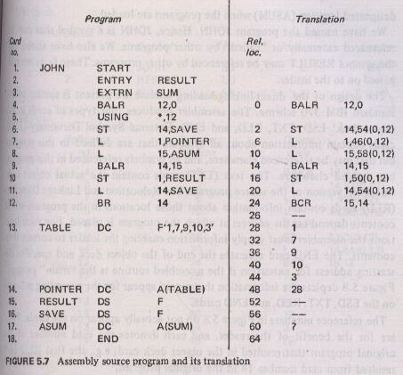
Direct linking loader

Slide 38
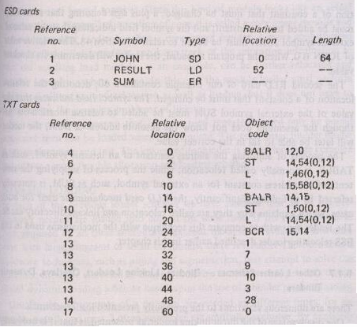
Direct linking loader Example object deck

Slide 39
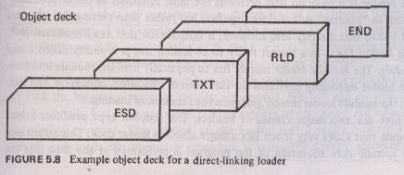
Direct linking loader Example object deck
RLD cards
Reference no. | Symbol | Flag | Length | Relative location
14 | JOHN | + | 4 | 48
17 | SUM | + | 4 | 60

Slide 40
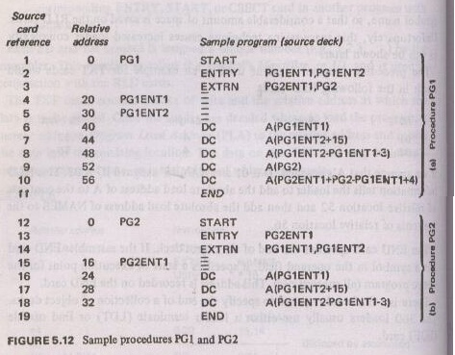
Example of a Direct-linking loader

Slide 41
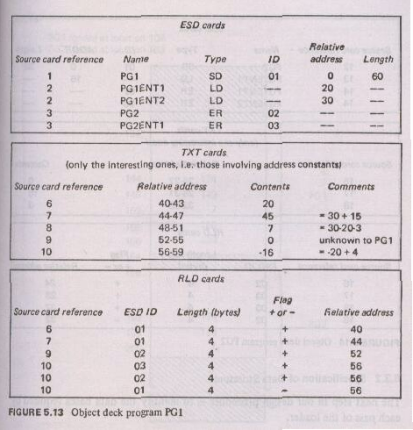
Example of Direct-linking loader

Slide 42
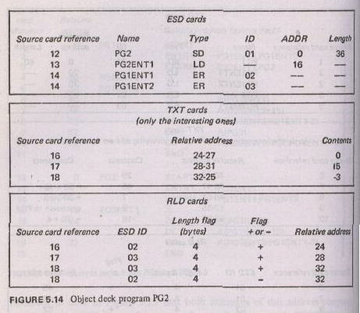
Example of a Direct-linking loader

Slide 43
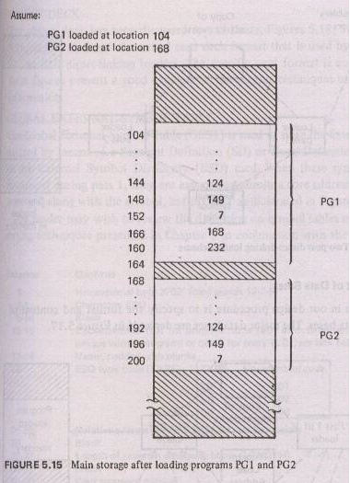
Example of a Direct-linking loader

Slide 44
7. A binder and a module loader
A binder is a program that performs the same functions as the direct-linking loader in “binding” subroutines together, but rather than placing the relocated and linked text directly into memory, it outputs the text as a file or card deck.
This output file is in a format ready to be loaded which is called as load module.
The binder essentially performs the functions of allocation, relocation, and linking; the module loader performs the function of loading.
A sophisticated binder is linkage editor

Slide 45
A binder and a module loader
Classes of binders
Core image builder
The specific core allocation of the program is performed at the time that the subroutines are bound together.
Linkage editor
Can keep track of the relocation information so that the resulting load module, can be further relocated & loaded anywhere in core.

Slide 46
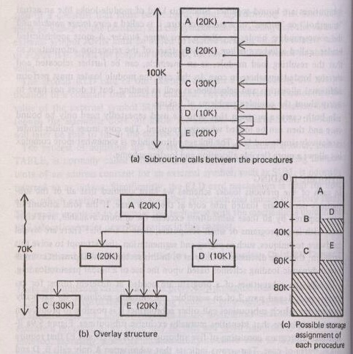
8. Dynamic loading

Slide 47
Dynamic loading
In order for overlay structure to work it is necessary for the module loader to load the various procedures as they are needed.
The portion of the loader that actually intercepts the “calls” and loads the necessary procedure is called the overlay supervisor or flipper.
This overall scheme is called dynamic loading or load-on-call (LOCAL).

Slide 48
9. Dynamic linking
Loading and linking of external references are postponed until execution time
Assembler produces text, binding and relocation information from a source language deck.
The loader loads only the main program.

Slide 49
BASIS FOR COMPARISON | LINKER | LOADER
Basic | It generates the executable module of a source program. | It loads the executable module to the main memory.
Input | It takes as input, the object code generated by an assembler. | It takes executable module generated by a linker.
Function | It combines all the object modules of a source code to generate an executable module. | It allocates the addresses to an executable module in main memory for execution.
Type/Approach | Linkage Editor, Dynamic linker. | Absolute loading, Relocatable loading and Dynamic Run-time loading.

Slide 50
Summary
Loading - which allocates memory location and brings the object program into memory for execution - Loader
Linking- which combines two or more separate object programs and supplies the information needed to allow references between them - Linker
Relocation - which modifies the object program so that it can be loaded at an address different from the location originally specified - Linking Loader

Slide 51
References
D. M. Dhamdhere, Systems Programming and Operating Systems, Tata McGraw-Hill, ISBN 13:978-0-07-463579-7, Second Revised Edition
J. J. Donovan, Systems Programming, McGraw-Hill, ISBN 13:978-0-07-460482-3, Indian Edition
Leland L. Beck, “System Software : An introduction to systems programming”
https://techdifferences.com/difference-between-linker-and-loader.html
https://www.embhack.com/difference-between-linker-and-loader/
https://techblogmu.blogspot.com/
https://www.geeksforgeeks.org/

Slide 52


